Slide 1
Base24 Config Files
Maintenance and configurations

Slide 2
DCT USAGE
You can make changes to ATM screen displays,
State table entries, FIT table data, configuration parameters, and timers.
You then download these changes to the ATM using the DCT.

Slide 3
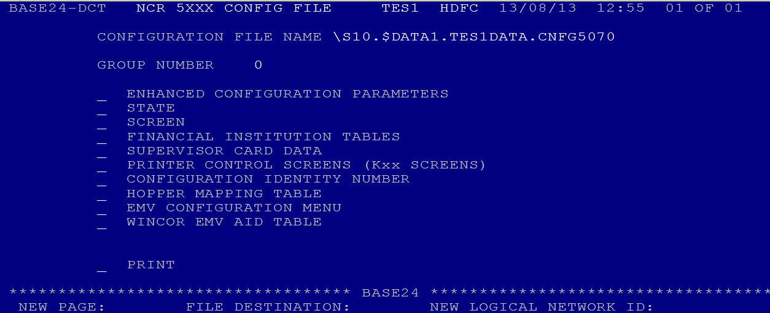
NCR 5XXX Configuration File Menu

Slide 4
State Table Data Screens
State tables are a number of sequential instructions that provide the ATM with the
information to perform financial and administrative transactions. The information
in the state tables is arranged in a hierarchical manner using state types and groups.
A state type is one action or condition of the ATM, such as waiting for the
cardholder to first insert a card. A group is a set of state types and screens that
provide a certain functionality, such as a fast cash withdrawal.

Slide 5
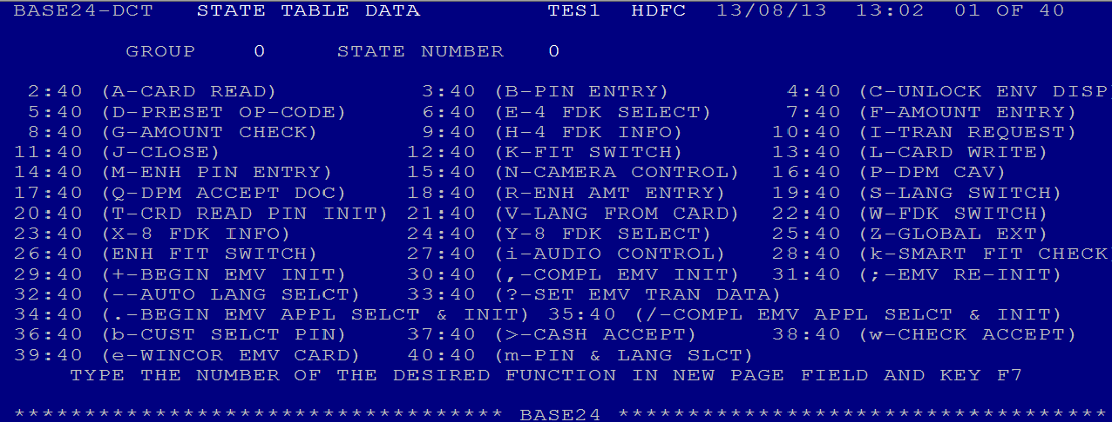
State Table Data Menu

Slide 6
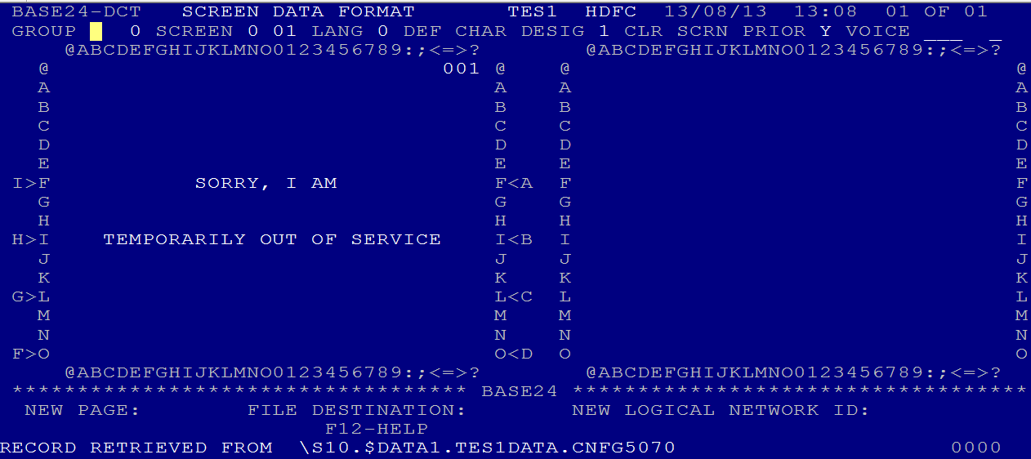
Screen Data Format Screen

Slide 7
Special Characters
The following special characters are entered on the right-side screen data layout.
These characters are not displayed on the cardholder screen, but have a special
meaning to the configuration editor.
The uppercase character C tells the editor where to position the cursor on a
cardholder screen. The uppercase character C must be entered on a line by itself.
using this special character for cursor position.
The uppercase character N instructs the editor to display the cardholder’s name
from Track 1.

Slide 8
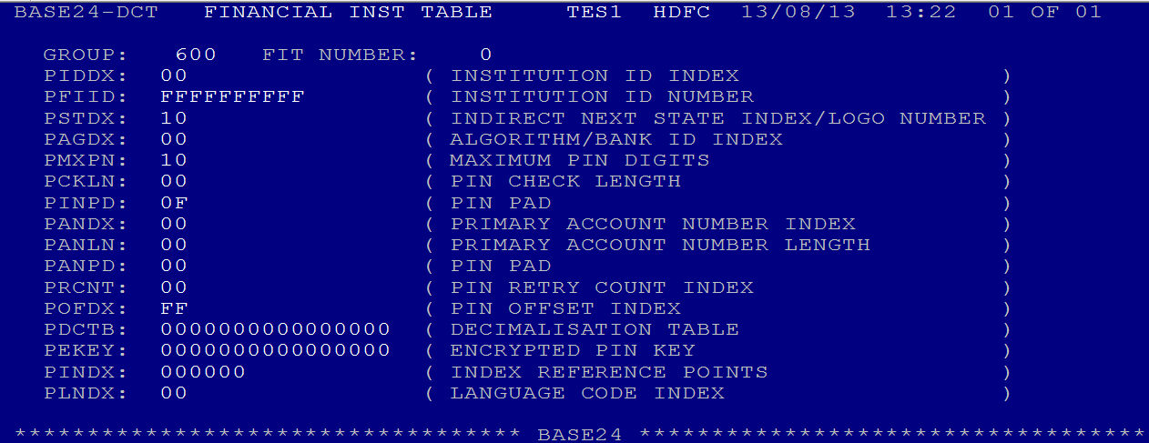
Financial Institution Table Screen

Slide 9
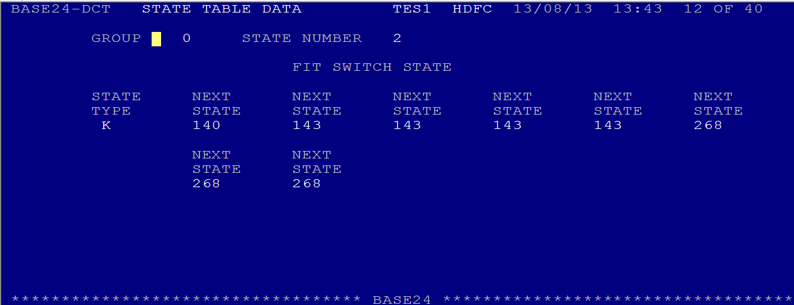
FIT SWITCH STATE

